Slide 1
ENDOCRINE SYSTEM
FEEDBACK MECHANISM
-> GROUP : 6

Slide 2
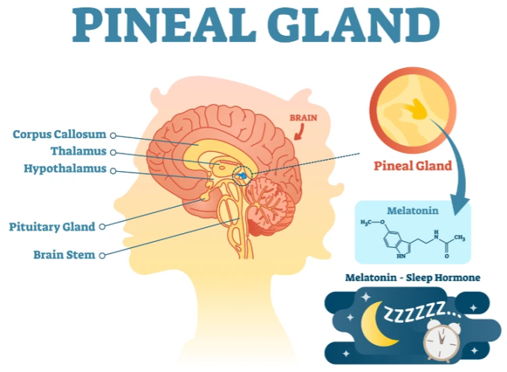
PINEAL GLAND
Location and Anatomy
Size: Measures about 5 to 8 mm in humans (the size of a grain of rice) and weighs roughly 100 to 180 mg.
Position: Sits in the midline of the brain, nestled in a groove between the thalamic bodies and just behind the third ventricle.
Structure: Part of the epithalamus, made up of specialized secretory cells called pinealocytes
Core Functions:-
Circadian Rhythm: Regulates the body's internal biological clock by releasing melatonin in response to darkness.
Reproductive Support: Influences sexual maturation and endocrine functions, particularly during puberty.

Slide 3
HYPOTHALAMUS
Location and Size
Sits deep inside the center of the brain.
Located right below the thalamus and directly above the pituitary gland.
Weighs only about 4 grams, making up a very small part of the total brain

